Slide 1
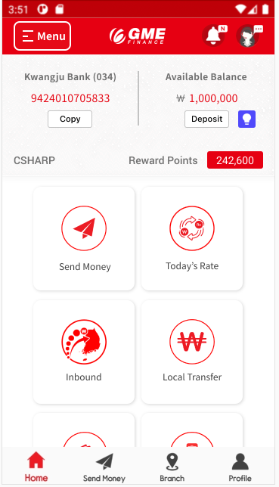
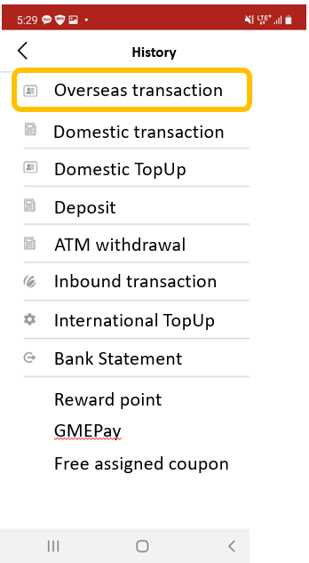

History

Slide 2
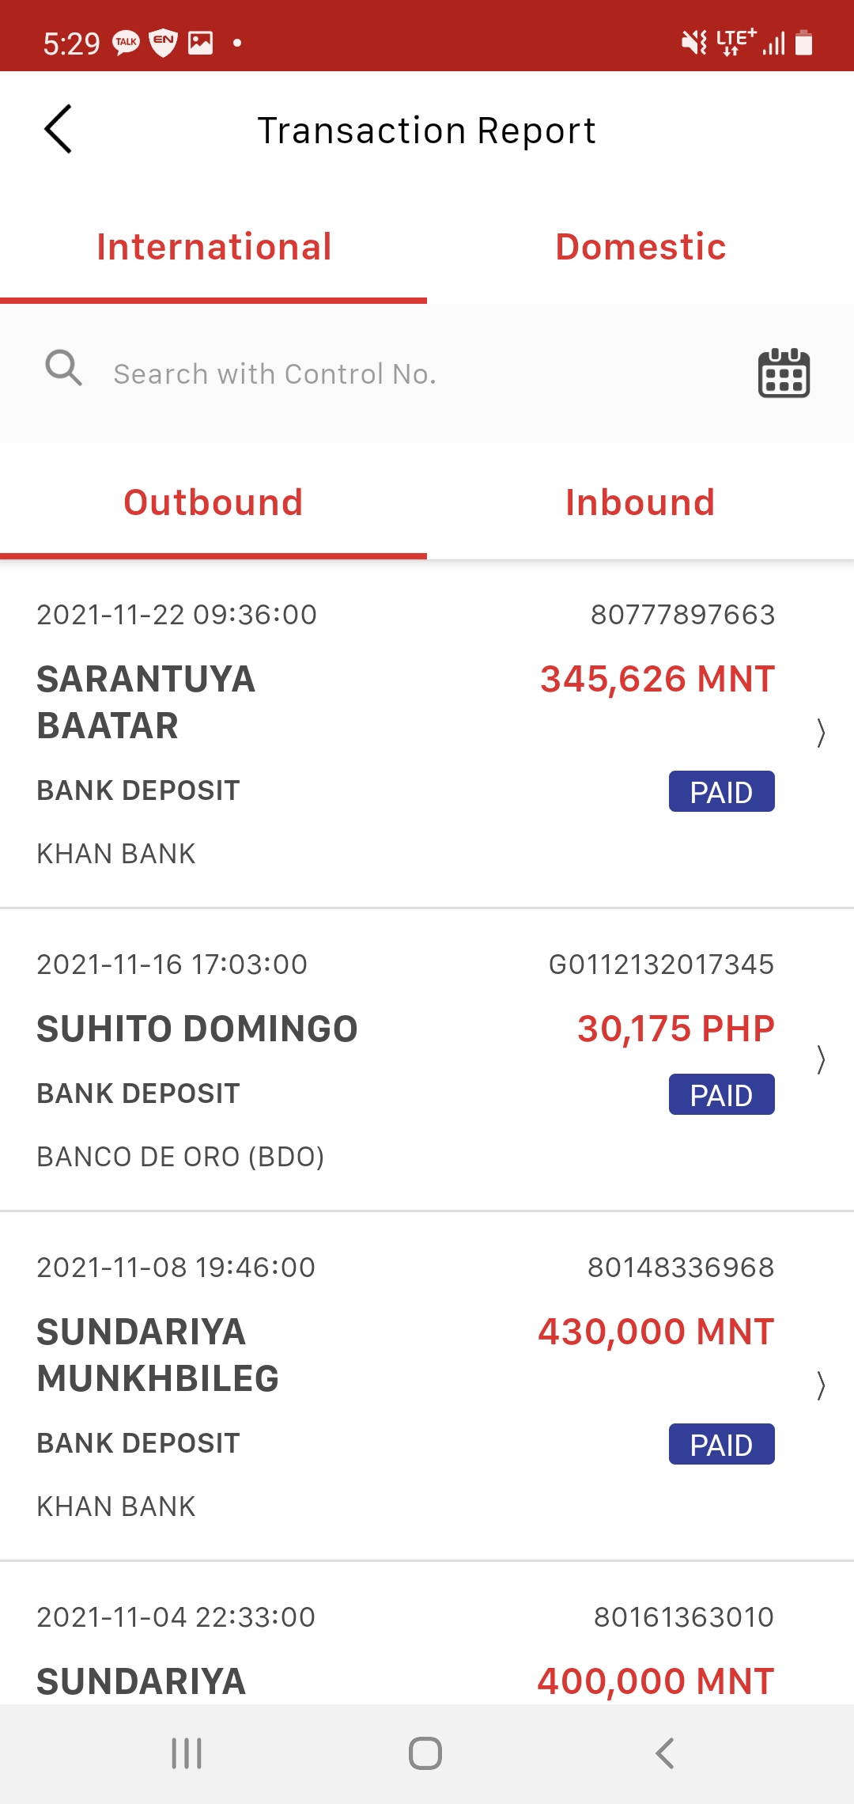
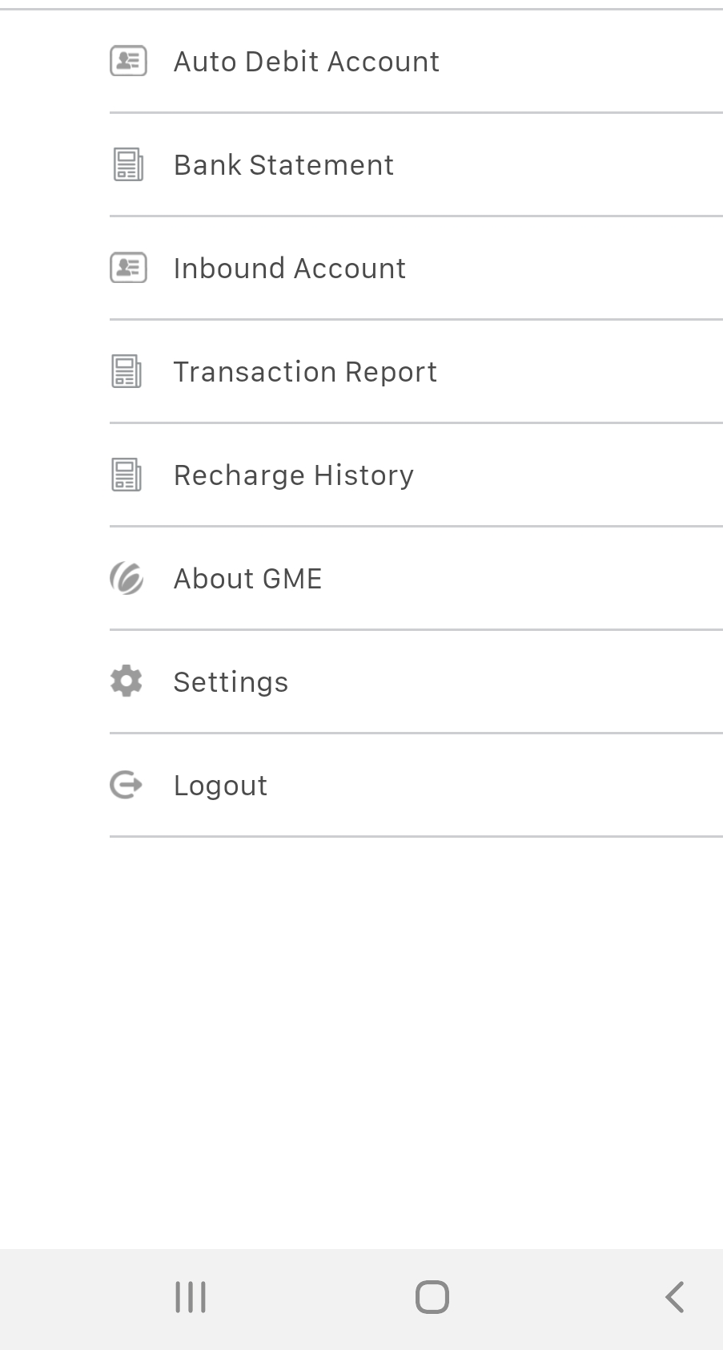


History
Overseas Transaction Report
Overseas transaction
Domestic transaction
1 month
3 months
12 months
Domestic TopUp
Deposit
ATM withdrawal
Inbound transaction
International TopUp
Bank Statement
Reward point
GMEPay
Free assigned coupon
After pressing download button, transaction statement will be download in PDF format (refer to next page).

Slide 3
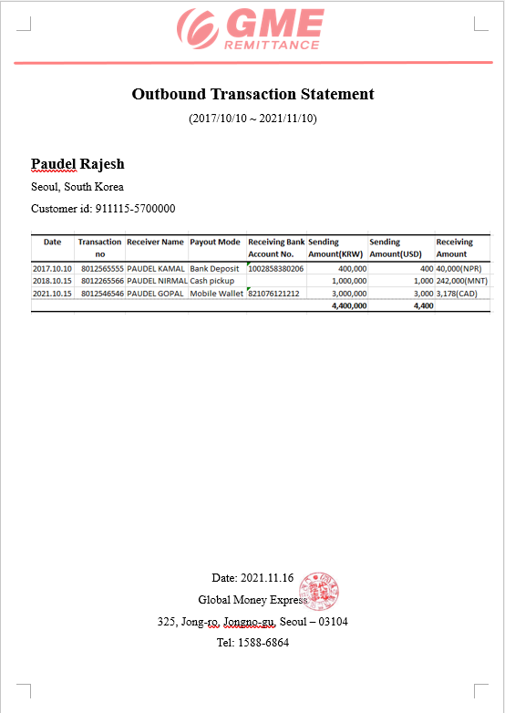

Slide 4
History
Domestic Transaction Report
Overseas transaction
Domestic transaction
1 month
3 months
12 months
Domestic TopUp
Deposit
ATM withdrawal
Inbound transaction
International TopUp
Bank Statement
Reward point
GMEPay
Free assigned coupon
After pressing download button, transaction statement will be download in PDF format (refer to next page).

Slide 5
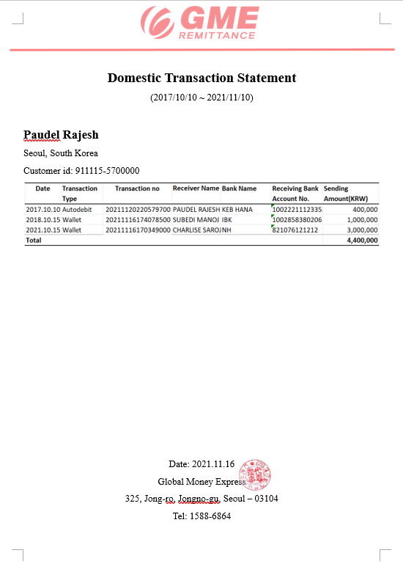

Slide 6

History
Deposit Report
Overseas transaction
Domestic transaction
1 month
3 months
12 months
Domestic TopUp
Deposit
CU
+ 500,000 KRW
ATM withdrawal
Convenient store deposit
Inbound transaction
Lotte ATM
+ 1,000,000 KRW
International TopUp
ATM deposit
Bank Statement
KJ deposit
+ 5,000,000 KRW
Reward point
KJ deposit
GMEPay
Gift coupons

Slide 7
History
Deposit Report
Overseas transaction
Domestic transaction
1 month
3 months
12 months
Domestic TopUp
Deposit
Lotte ATM
- 300,000 KRW
ATM withdrawal
ATM withdrawal
Inbound transaction
Hyosung ATM
- 50,000 KRW
International TopUp
ATM withdrawal
Bank Statement
Reward point
GMEPay
Gift coupons

Slide 8
History
Inbound Transaction Report
Overseas transaction
Domestic transaction
1 month
3 months
12 months
Domestic TopUp
Deposit
ATM withdrawal
Inbound transaction
International TopUp
Bank Statement
Reward point
GMEPay
Gift coupons
After pressing download button, transaction statement will be download in PDF format (refer to next page).

Slide 9
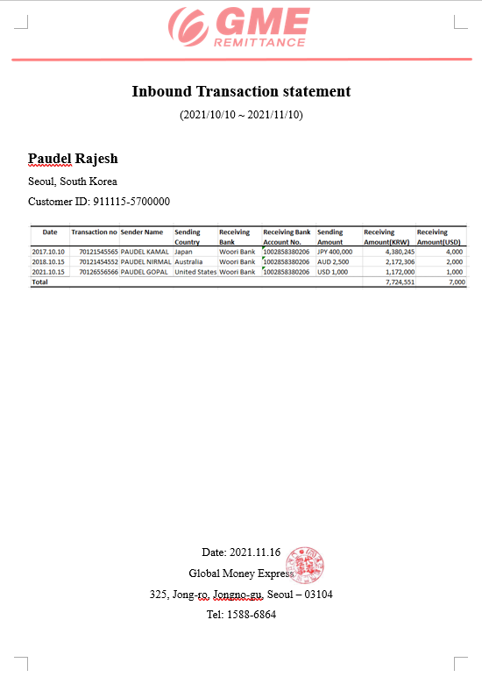

Slide 10
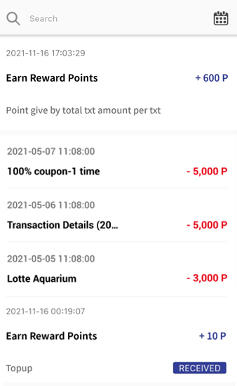
History
Overseas transaction
Domestic transaction
Overseas transaction point
Domestic TopUp
27,600 P
Deposit
ATM withdrawal
Inbound transaction
27,000 P
International TopUp
Bank Statement
32,000 P
Reward point
GMEPay
37,000 P
Gift coupons
TopUp point
40,000 P

Slide 11



History
Overseas transaction
Recharge from Autodebit
+ 3,000,000 KRW
Domestic transaction
4,100,000 KRW
Domestic TopUp
Deposit
ATM withdrawal
Recharge from Wallet
+ 1,000,000 KRW
1,100,000 KRW
Inbound transaction
International TopUp
- 25,000 KRW
Bank Statement
100,000 KRW
Reward point
GMEPay
Gift coupons
- 5,000 KRW
125,000 KRW
- 25,000 KRW
Used Point: 3,000 Point
Total Paid: 28,000 KRW

Slide 12
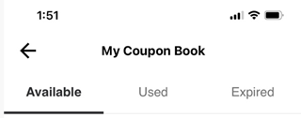
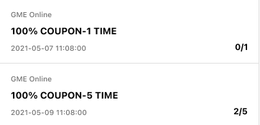
History
Coupon box
Coupon box
Overseas transaction
Domestic transaction
Domestic TopUp
~ 2022-05-07 23:59
Deposit
Used date: 2022-05-07 11:08:00
Transaction no: 80202950380
Gift coupon
ATM withdrawal
~ 2022-05-09 23:59
Used date: 2022-05-05 10:30:00
Transaction no: 80202950381
Inbound transaction
International TopUp
Bank Statement
Reward point
Coupon box
GMEPay
Coupon box
Expired date: 2022-05-07 11:08:00

